Slide 1
Flood extent mapping

Slide 2
What solution is best suited for my case?
Terrain Type | Type of Flood Event |  |  |  |  |  | Available Imagery
 | Flash Flood |  | Seasonal Flood (< 2 months of rain) |  | Seasonal Flood (> 2 months of rain)
 | S1 | S2 | S1 | S2 | S1 | S2
not specific |  |  | AnomalyD |  |  |  | Every analysis is limited by data availability and data quality. While radar data is best suited for analysis floods (because it can penetrate clouds during rainy seasons), sometimes the data is not readily available and we need to utilize optical data, or combine the two data types.
wetlands |  |  | NDFI |  | NDFVI
mountainous | AnomalyD | SVM
urban |  |  |  | MNDWI | Data Fusion | Data Fusion
Data Type | Method | Alias
S1 | Anomaly Detection | AnomalyD
S1 | NDFI | NDFI
S1 | NDFVI | NDFVI
S2 | SVM | SVM
S2 | MNDWI | MNDWI
S1 + S2 | S1 NDFI + S2 MNDWI | Data Fusion

Slide 3
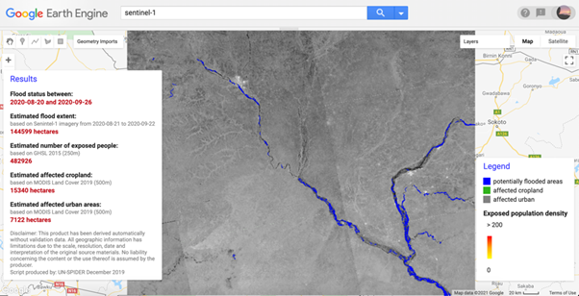
S1 – Anomaly Detection
This approach takes the advantage of using stack of images for the pre- and post- event by using their statistics for detecting the flood as an anomaly
Most suitable use cases: flood events where the flood area can be clearly detected from the surrounding environment
Niger floods
(summer 2020)

Slide 4
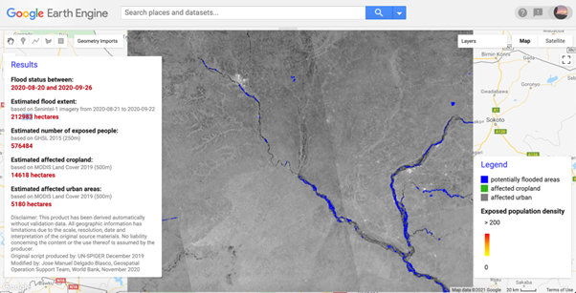
S1 – NDFI
This approach is based on this paper from 2018 (https://doi.org/10.1016/j.rse.2018.03.006) –while it is based as well in the SAR backscatter statistics , it defines a Normalized Difference Flood Index, applicable to any X- and C- band SAR sensors. The typical value for this threshold is 0.7, but the authors does not suggest to go lower than 0.6
Most suitable use cases: flat terrains with low vegetation prone to recurrent seasonal floods, wetlands
NDFI= (mean
(reference)-min⁡(reference+
flood))/
(mean(
reference)+min⁡(reference+flood))
Niger floods
(summer 2020)

Slide 5
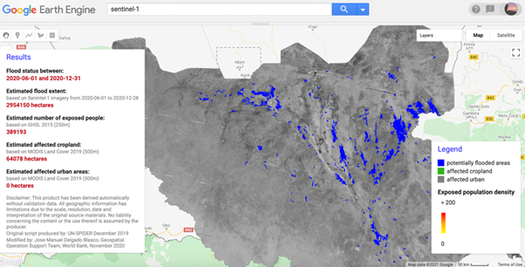
S1 – NDFVI
This index detects water in shallow vegetation, and its suggested threshold is 0.75. In some instances, it is worth combining the 2 indexes, depending on the terrain of the AOI.
Most suitable use cases: we recommend using this index when the flooded areas occur in fields with shallow vegetation
NDFVI= ( max⁡(reference+ flood)-mean(reference)) /
(max⁡(
reference+
flood)+mean (reference) )
SSD floods
(summer 2020)

Slide 6
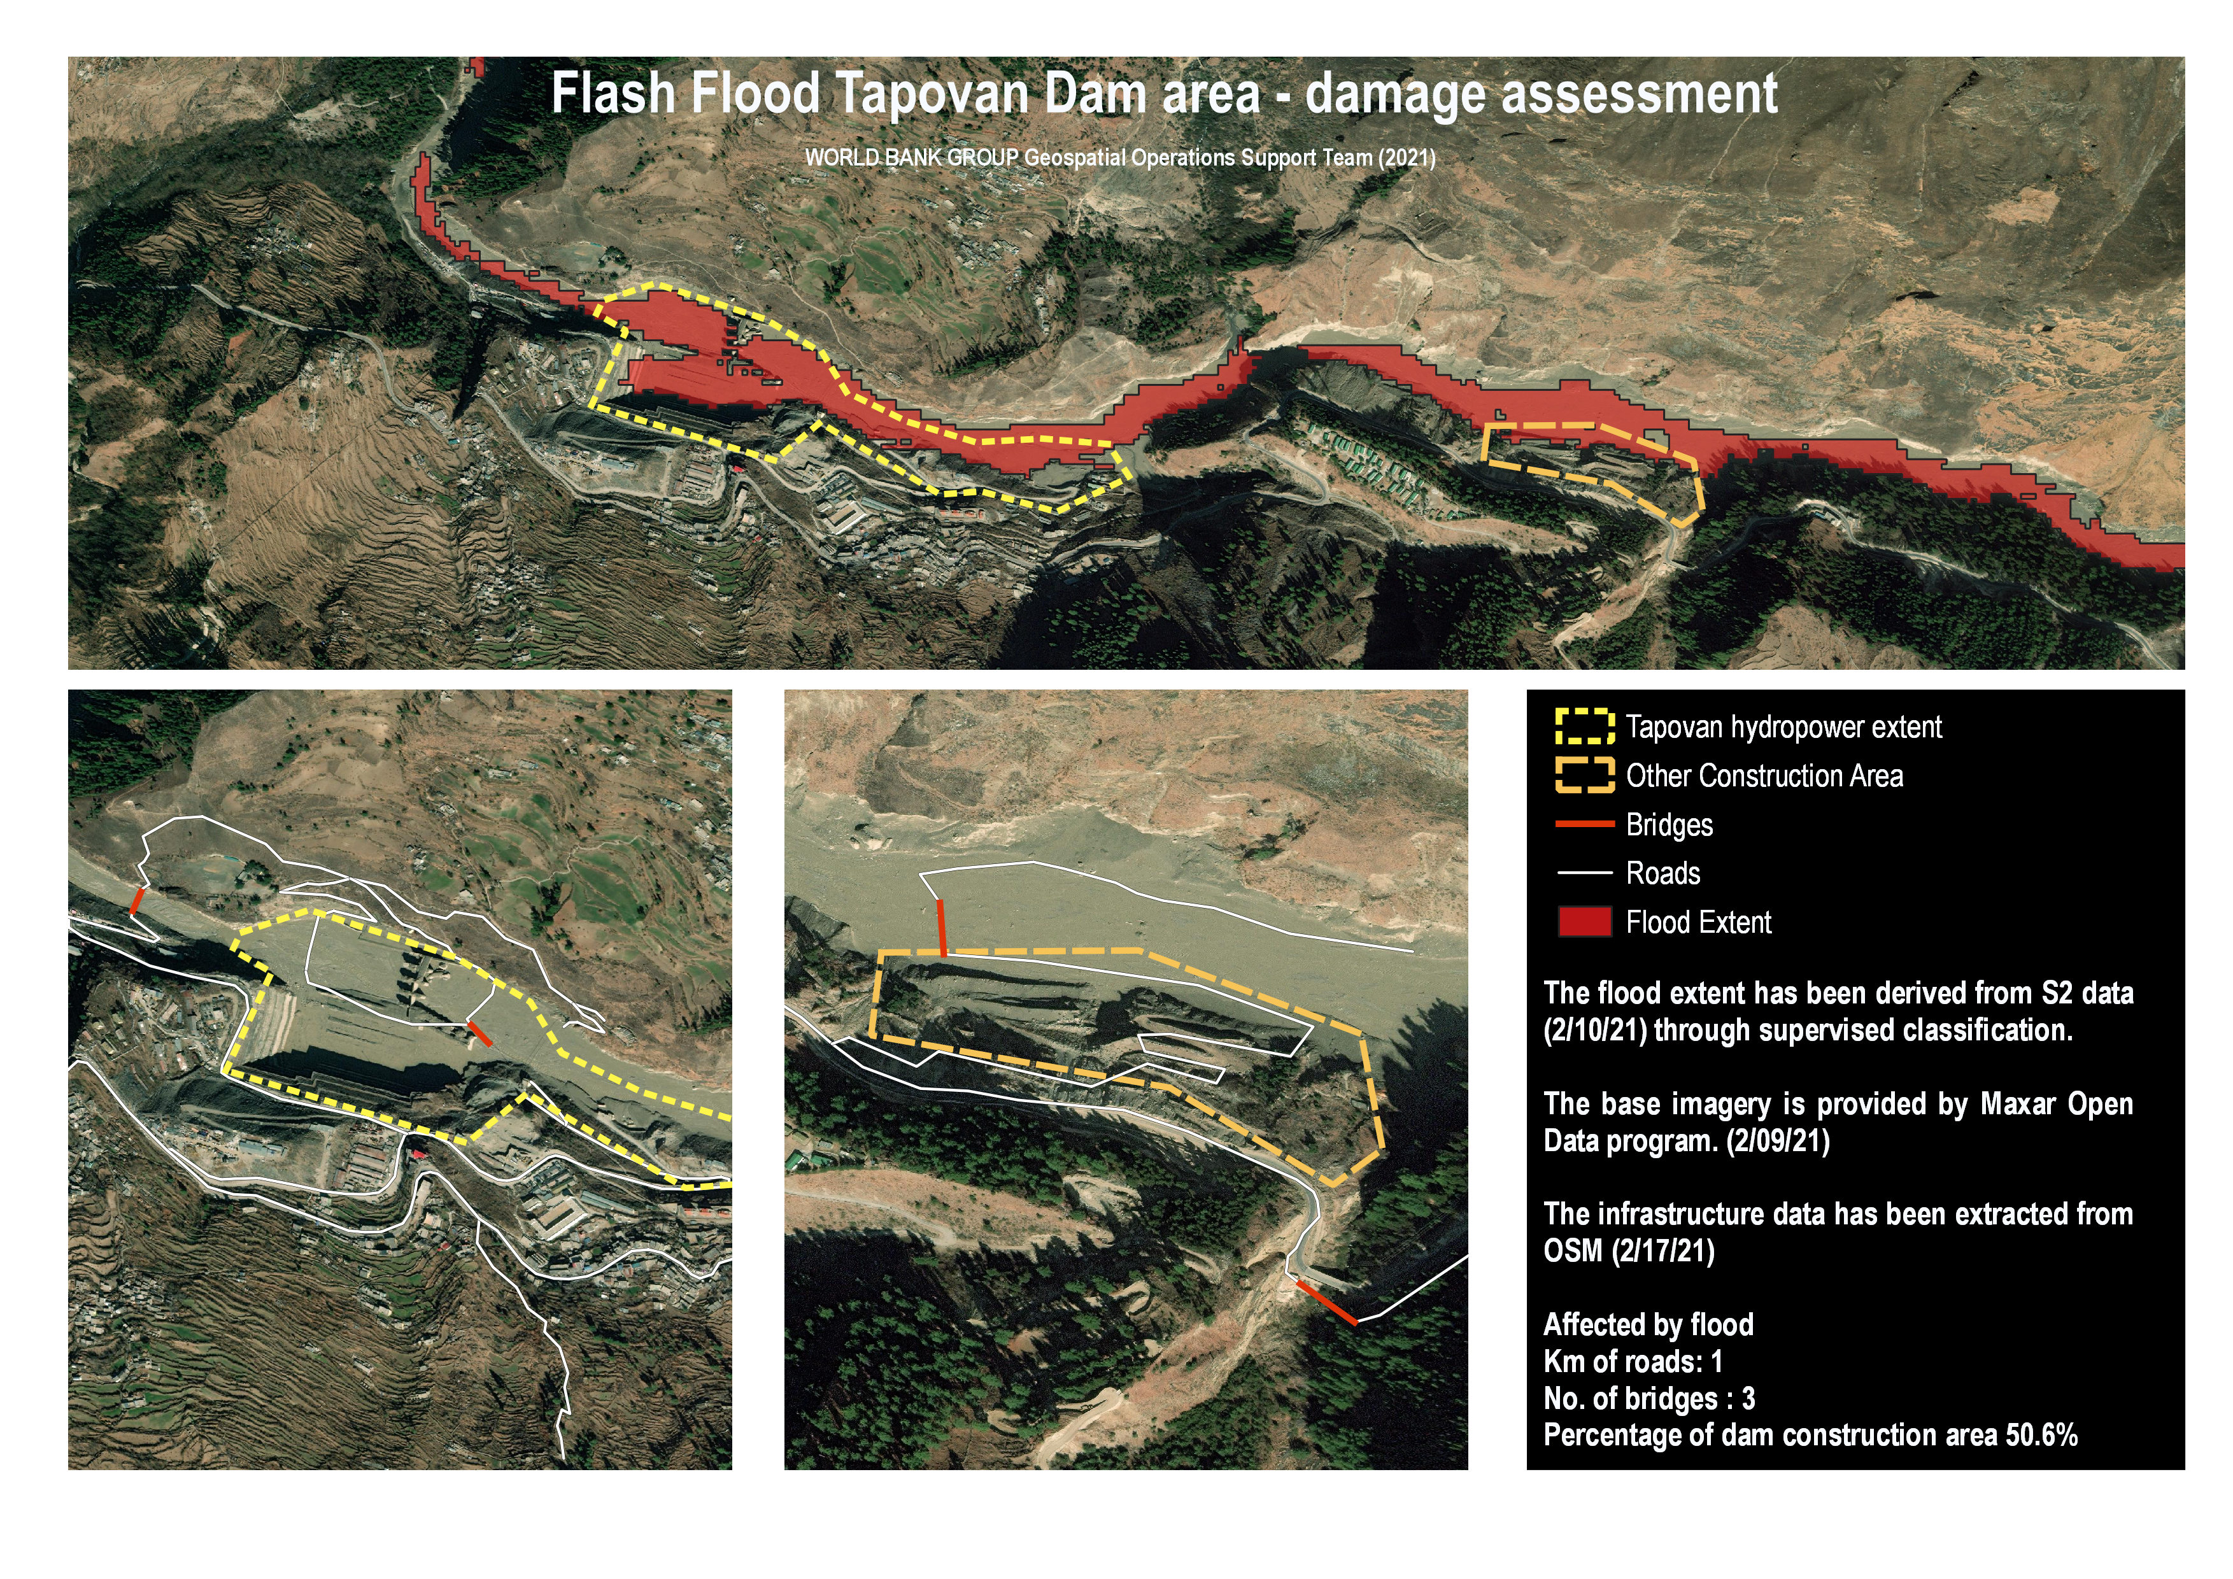
S2 – SVM
In some instances, radar data might not be available in time for a flood mapping analysis but optical data might capture the event just at the right moment. Flood extent mapping can be determined using optical imagery together with image classification techniques.
SVM (Support Vector Machine) is an algorithm utilized in supervised classification, where the users first need to create training samples for each class of pixels (e.g urban, forest, water) and the algorithm uses the spectral signature thus generated to classify the entire image.
Tapovan Dam,
India
Flash flood

Slide 7
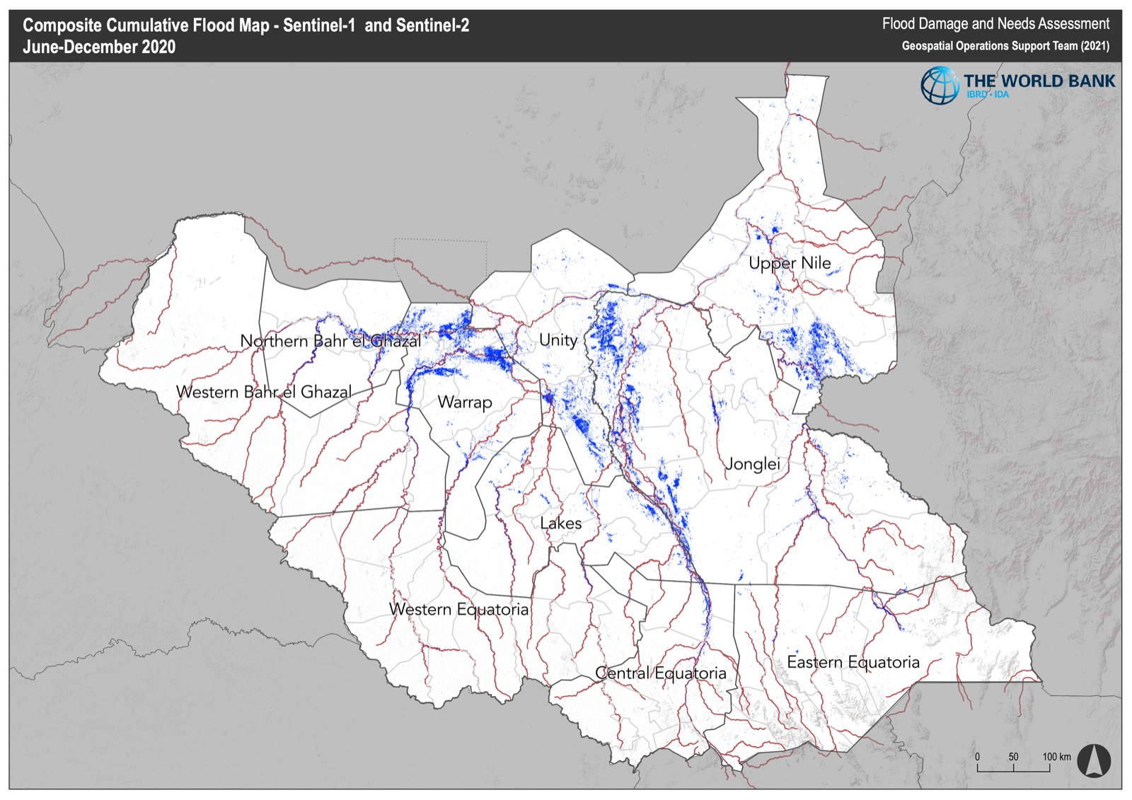
S1 + S2 Data Fusion
The approach of S1 and S2 fusion is suitable for cases with long flood periods (several months) for which monthly cloud free composites are of good quality to derive MNDWI from optical data. Combining it with S1, it provides more frequent updates and increases the detection of flooded areas, as both sensors are complementary. S1 flood maps underestimate flood over urban areas, as a well-known phenomena of the SAR signal over flooded cities.
South Sudan,
2020 floods
This script was developed as part of the South Sudan Flood Damage and Needs Assessment with funding from the GFDRR JIT Recovery and PDNA Facility

